Slide 1
Activity 8 – Morphological Operation
Kenneth M. Leo
2015-13015
Score: 12/10
Link: http://tiny.cc/Activity8AP186

Slide 2

Original Images/Objects used

Slide 3
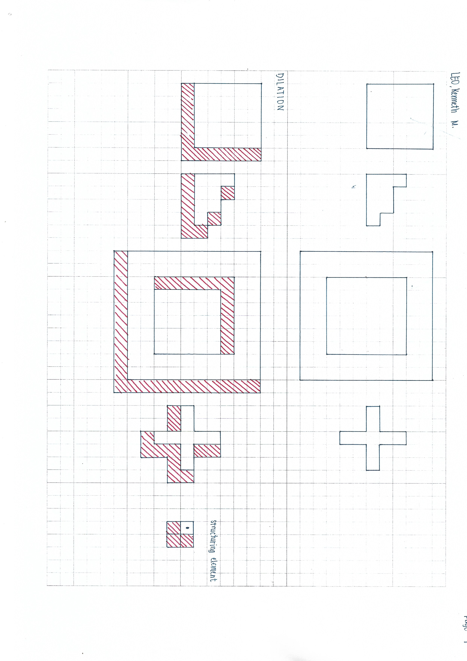
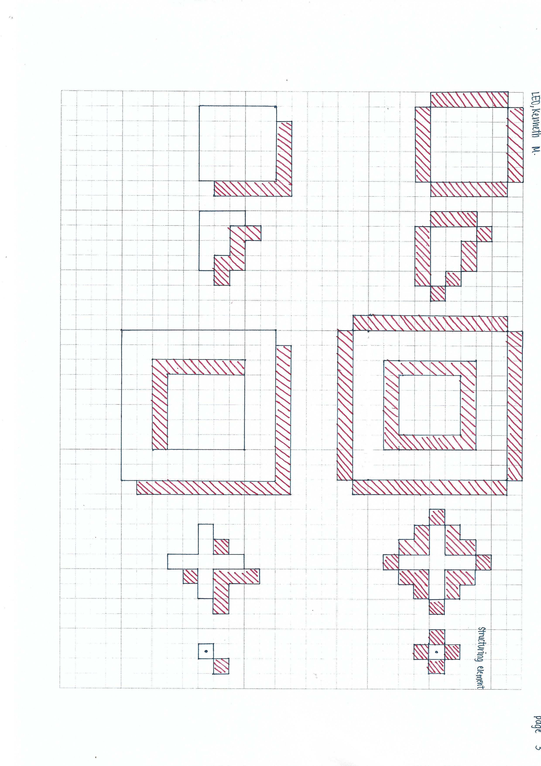
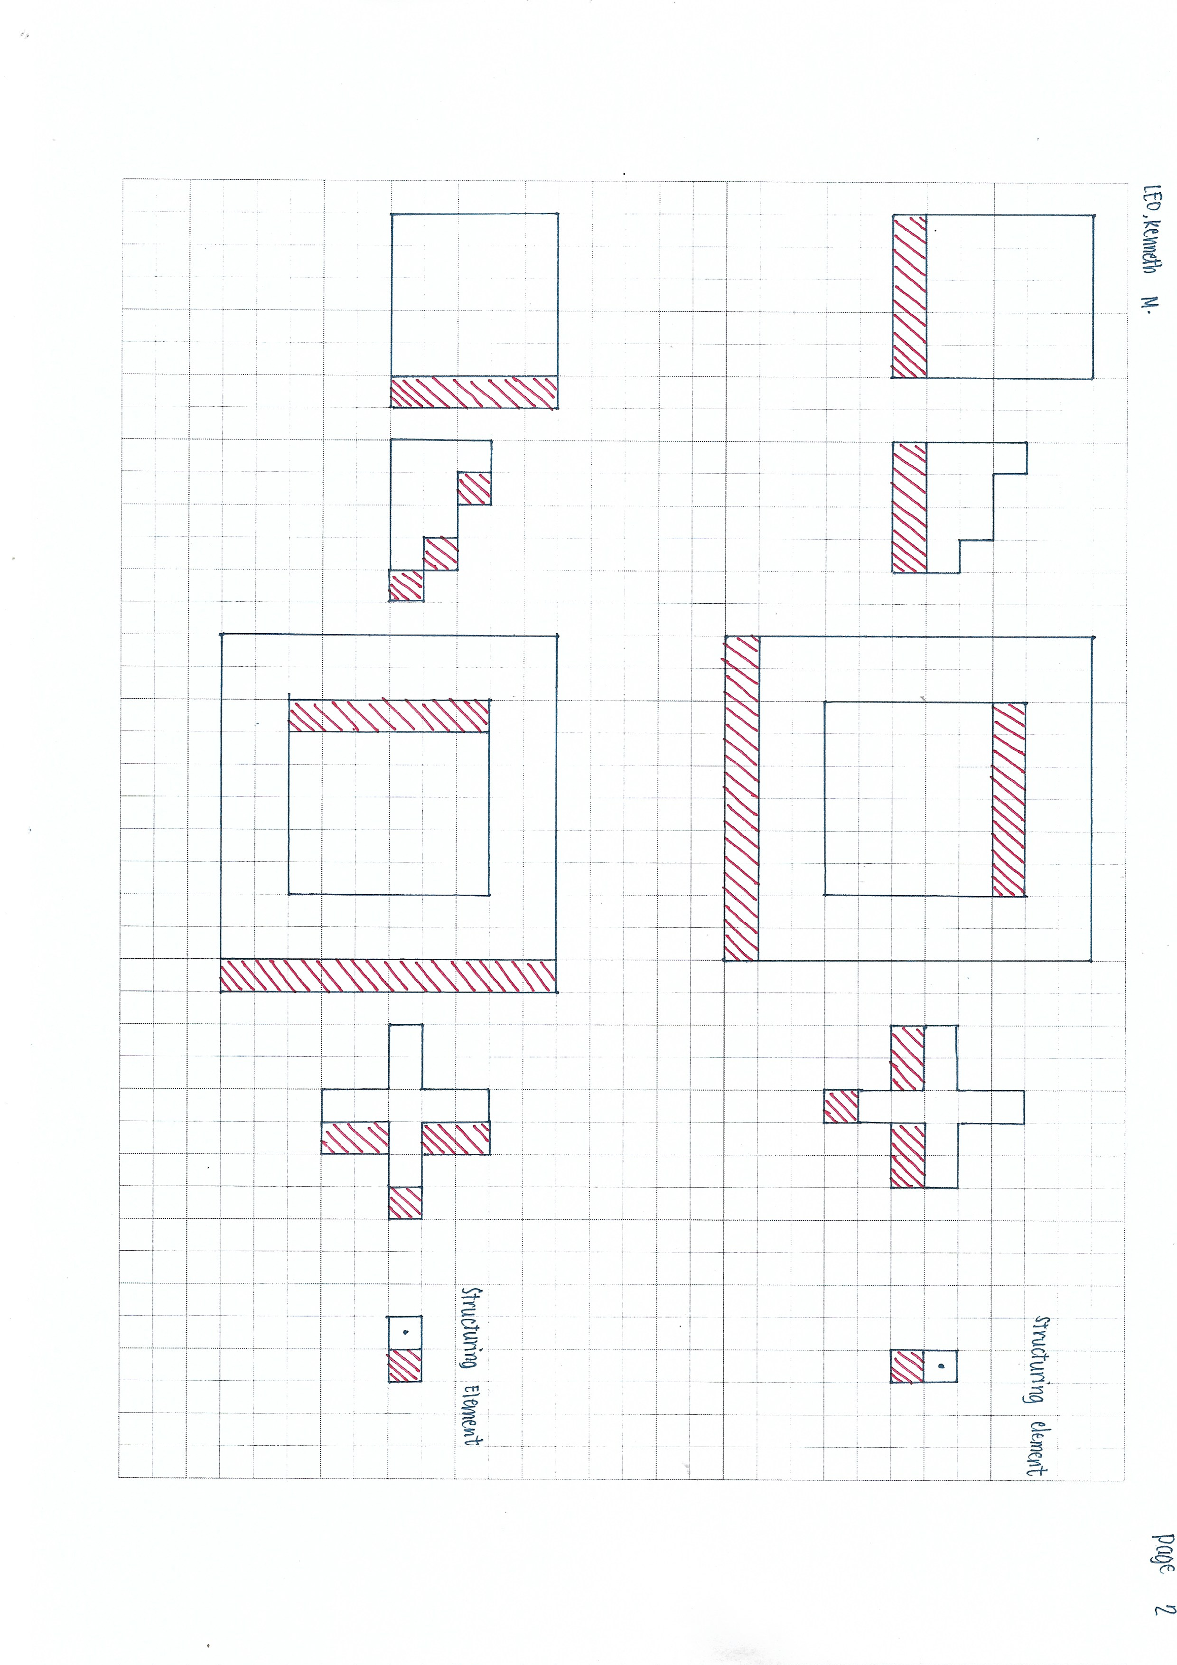
Predictions: Dilation

Slide 4
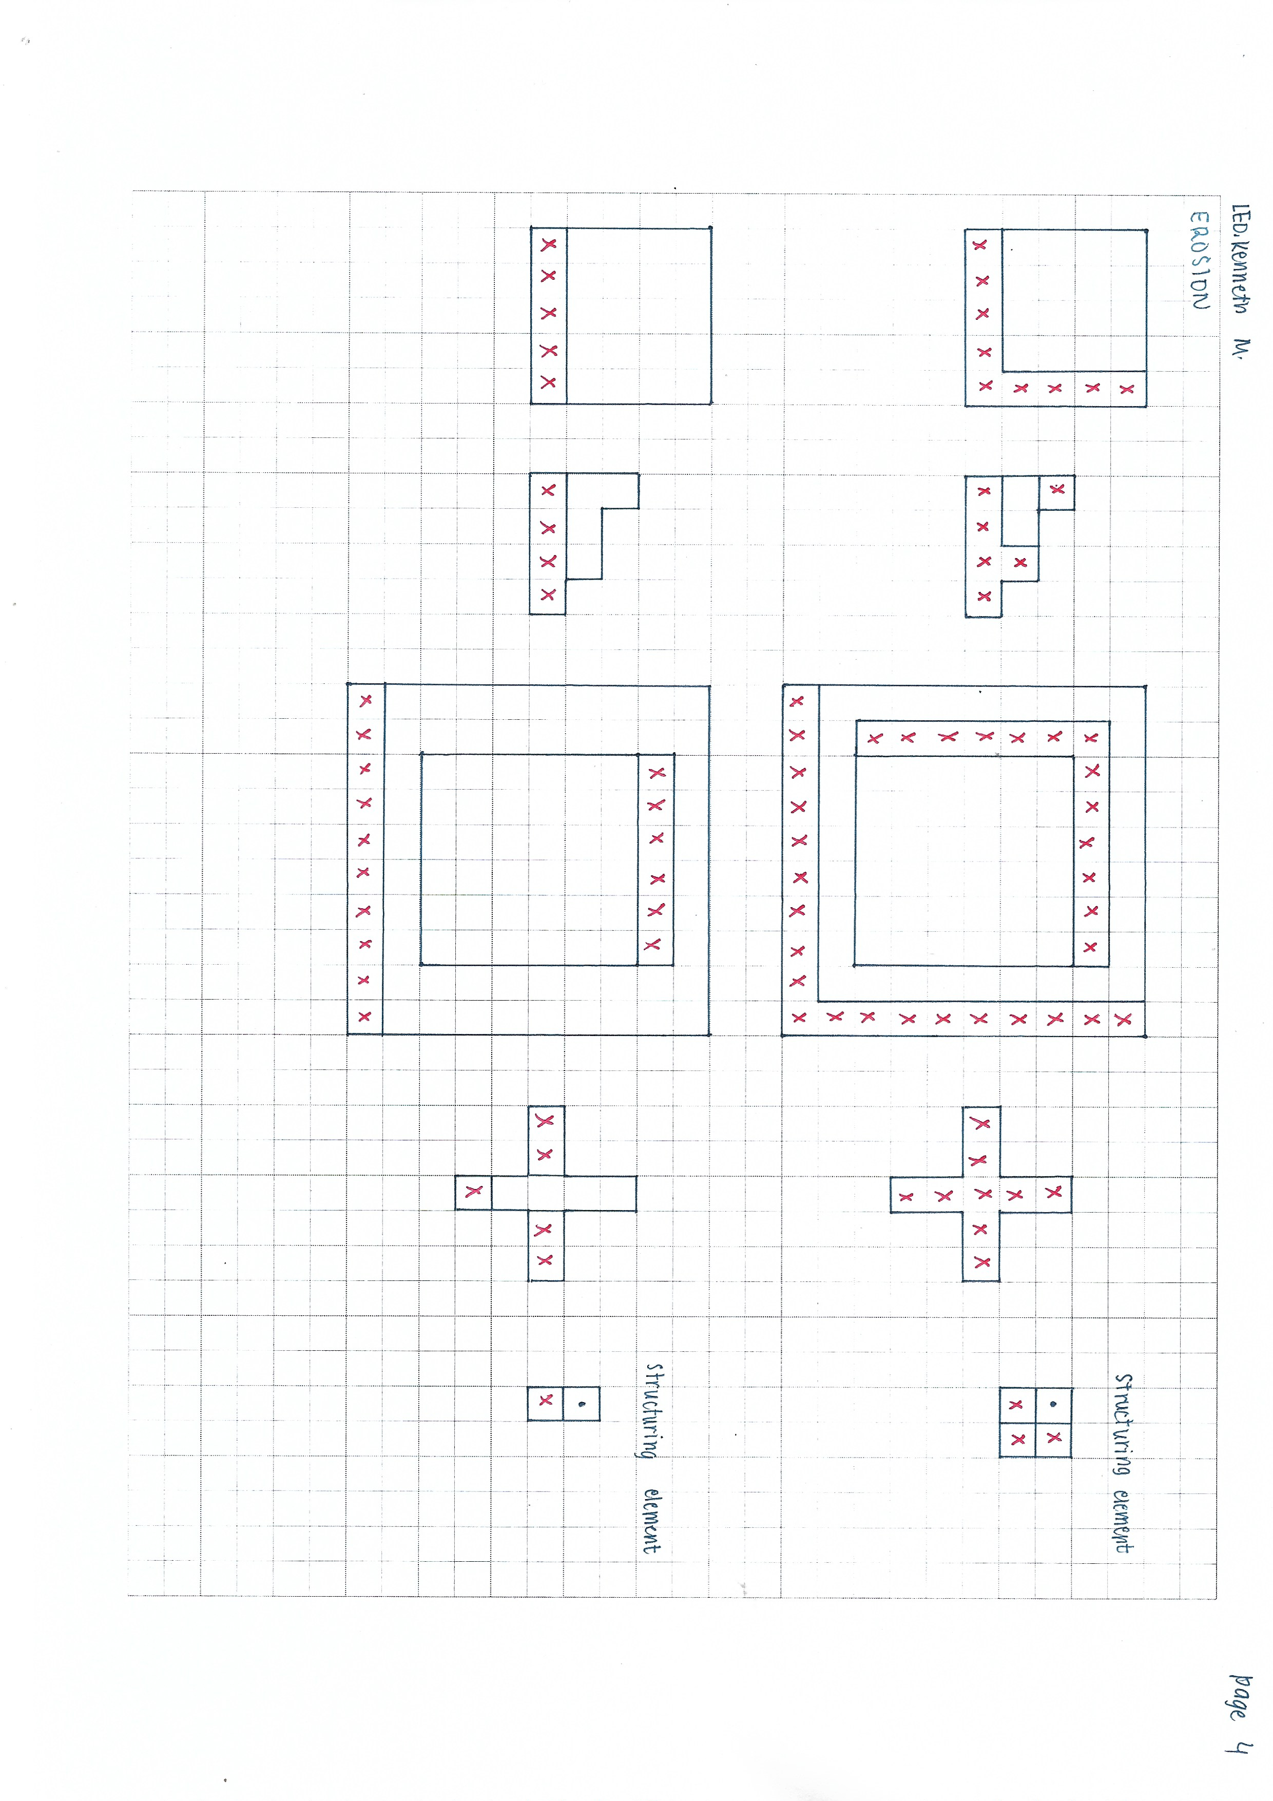
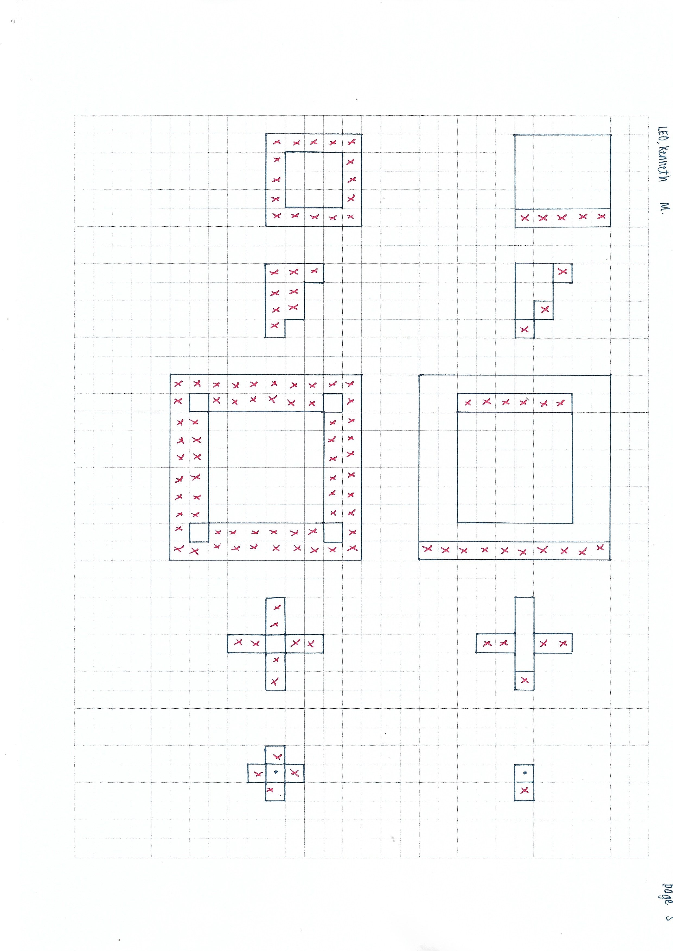
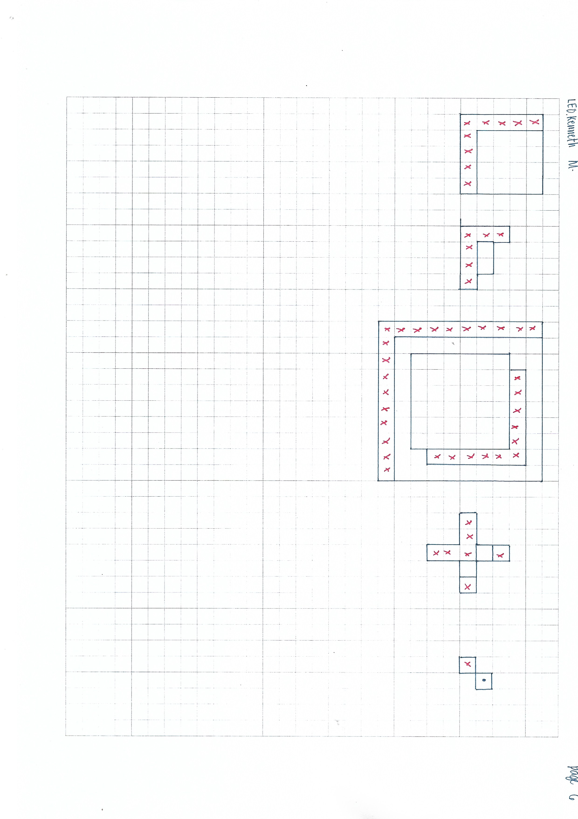
Predictions: Erosion

Slide 5















Actual results
Structuring element
Dilation
Erosion

Slide 6
Discussions
We can see from the figures that dilating an object with a certain structural element adds additional ‘pixels’ to the object.
For each pixel of the object, we dilate it using the structuring element such that if the pixel location of the intersection of the pixel and the structuring element [we overlap one pixel of the structuring element to the object pixel] is empty, we add a value to it.
For erosion, if the overlap has a pixel value, we remove it, if not, we remove the overlapped pixel.
We can also see that the hand drawn plots are similar to the python ones, difference is that the last structuring used are opposites which just shows that pixels are added on the opposite.

